Slide 1

DigPacks Translation

Slide 2
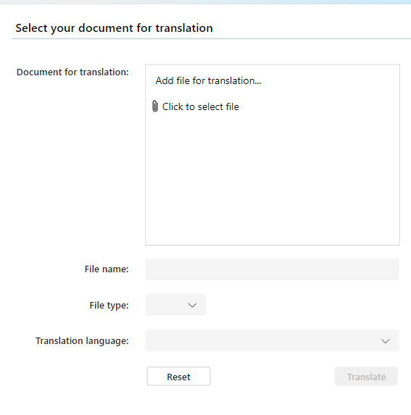
Single Document Translation
This solution gives you the option to translate documents to your chosen language.
This is achieved though the Translator Pro app where you select single document translation option.
Here you attach the file you want to translate as well as: the name of the translated file, file type and the language you wish to translate to.
Upon completing the translation, you will be given the option to download said file as well as the option to go back and use another one of our options.

Slide 3
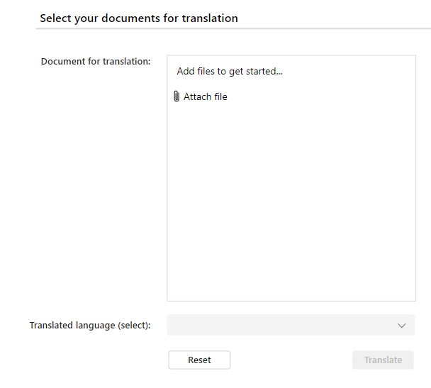
Batch Document Translation
This solution gives you the option to translate documents to your chosen language.
This can be done on up to 30 documents at once.
Upon opening the app, you will need to select the batch documents translation option and attach the files you wish to translate as well as the language you wish to translate to. Upon completion you will be given the option to open each individual translated document and an to go back to translate more document or select another option.
After translating you will be given the option to download, folders will be created in your OneDrive to organize your translated documents.

Slide 4
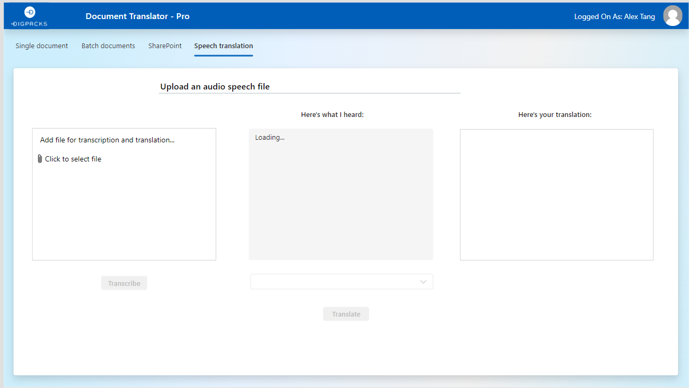
Speech Translation
This solution gives you the option to translate audio files to your chosen language.
This is done through the Translator Pro app and selecting the speech translation option.
Here you attach the audio file you wish to translate and click transcribe. After the audio file has been transcribed you can fix any errors you see in the text box, and then you select the language you wish to translate to and click translate. The translated text will be displayed in the textbox on the right of the screen.

